Slide 1
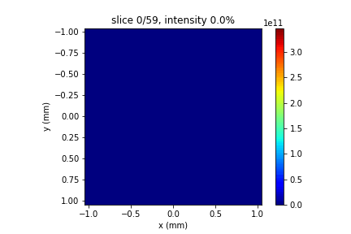
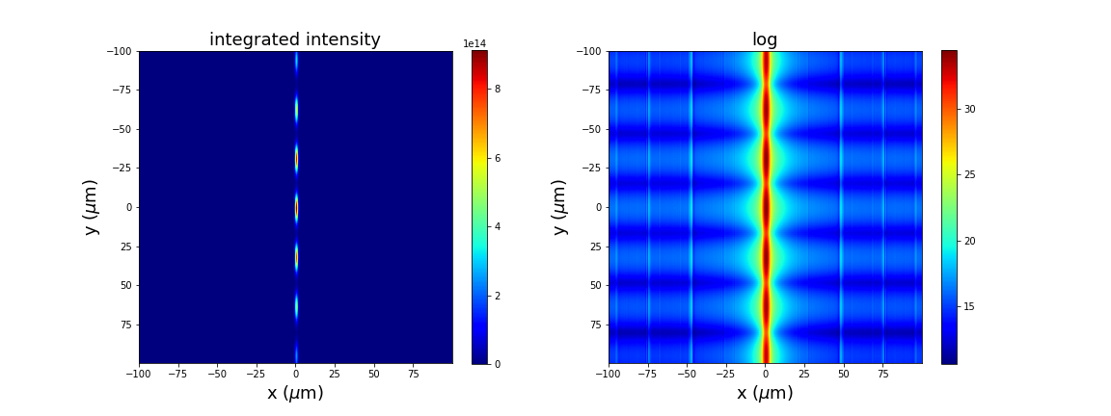
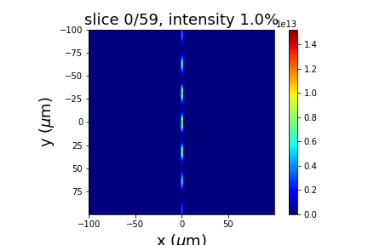
Input beam, 1fs, 60 slices
Integrated intensity over 60 slices
1fs, 60
Focused beam

Slide 2
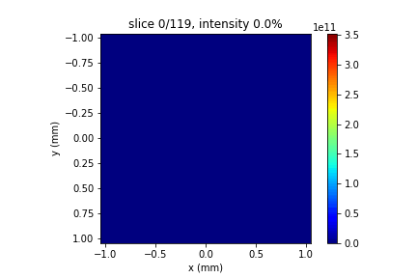
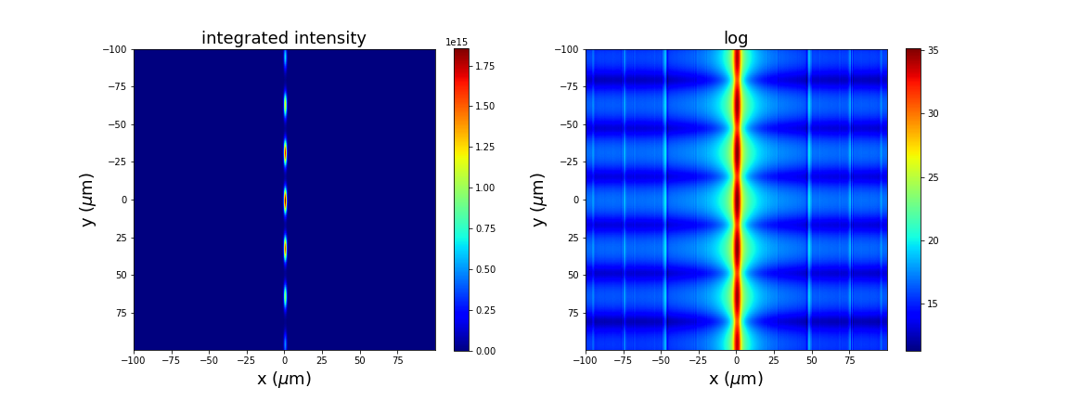

Input beam, 1fs, 120 slices
Integrated intensity over 120 slices
1fs, 120
Focused beam

Slide 3
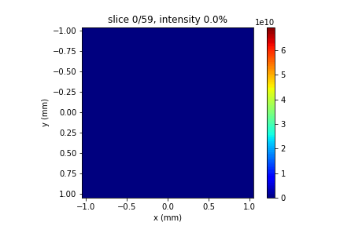
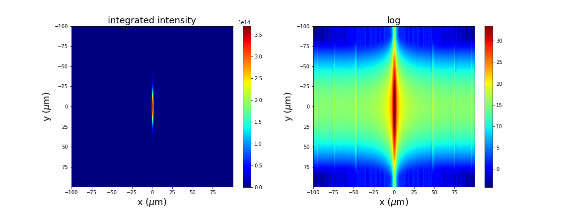

Input beam, 5fs, 60 slices
Integrated intensity over 60 slices
5fs, 60
Focused beam

Slide 4

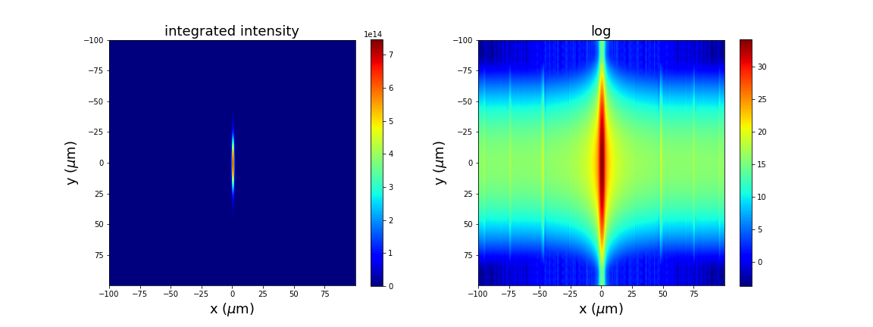

Input beam, 5fs, 120 slices
Integrated intensity over 120 slices
5fs, 120
Focused beam

Slide 5

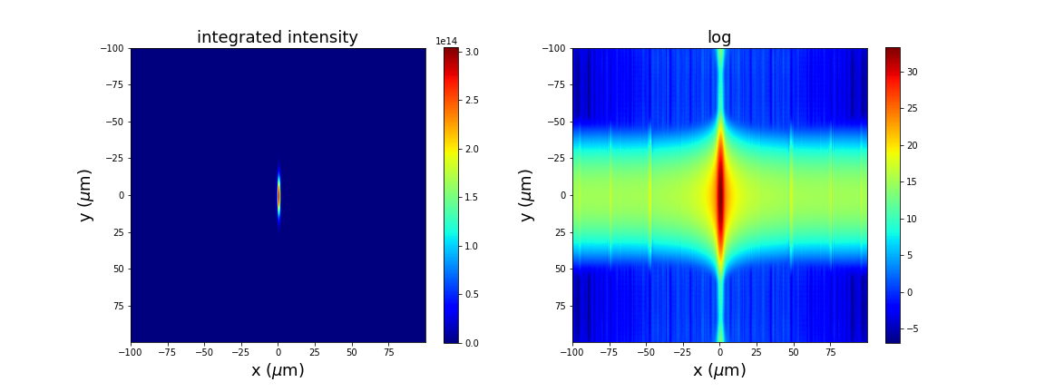
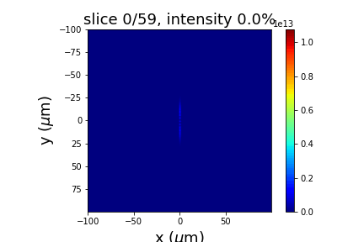
Input beam, 10fs, 60 slices
Integrated intensity over 60 slices
10fs, 60
Focused beam

Slide 6



Input beam, 10fs, 120 slices
Integrated intensity over 120 slices
10fs, 120
Focused beam

